Slide 1
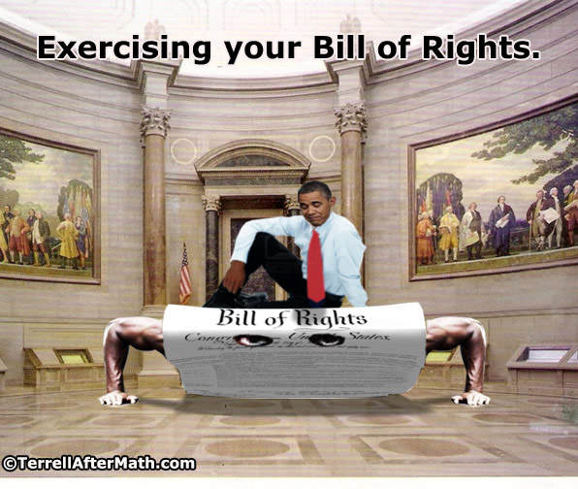
Chapter 5: The bill of Rights and civil liberties
Mrs. gillespie
Civics 7th Grade

Slide 2
FLORIDA Standards:
SS.7.C.2.4 - Evaluate rights contained in the Bill of Rights and other amendments to the Constitution.
SS.7.C.2.5 - Distinguish how the Constitution safeguards and limits individual rights.
SS.7.C.3.6 - Evaluate Constitutional rights and their impact on society.
SS.7.C.3.12 - Analyze the significance and outcomes of landmark Supreme Court cases.

Slide 3
PREVIEW
A high school principal has reason to suspect some students of bringing weapons onto campus. After receiving a tip from a teacher, the principal searches the lockers of three students and finds a knife and a small handgun in one student’s locker. The other two lockers turn up nothing.
1. In this situation, what rights do the students assigned to these lockers have?
2. What rights does the principal, acting on behalf of the student body, have?
3. On a high school campus, should authorities be allowed to search student lockers whenever they want?

Slide 4
5.1: Introduction
Read the introduction to Chapter 5 on pages 83-84.
1. What is the Espionage Act?
2. What did Schenck organize and what happened to him because of it?
3. What did the case Schenck v. United States allowed the courts to apply?

Slide 5
Homework
Read Chapter 5 Section 2

Slide 6
5.2: Defining and Protecting your rights and liberties
The Bill of Rights guarantees two types of rights:
Civil Liberties - Basic freedoms that are considered to be the birthright of all individuals (unalienable rights).
Freedom of speech
Freedom of religion
Freedom of press
Freedom of assembly
Freedom from unreasonable search and seizures
Civil Rights - Rights that come with being a member of society. These rights are guarantees by government through the law.
Right to due process
Right to trial by jury
Right to legal counsel
Right to vote
Right to petition the government for redress of grievances

Slide 7
Defining civil liberties and civil rights
When the framers wrote the U.S. Constitution they said almost nothing about the protection of individual rights and liberties from government abuses.
They spelled out many things that the government could do, but not much about what the government could not do.
That omission was rectified with the addition of the Bill of Rights (first 10 amendments).

Slide 8
Early challenges in enforcing the bill of rights
The Bill of rights defines rights and liberties in broad terms.
Before rights and liberties could be safeguarded (protected), the language of the Bill of Rights had to be interpreted and applied in actual circumstances.
This is done by the Supreme Court and its power of judicial review granted by the court case Marbury v. Madison.
At first, in 1833, Barron v. Baltimore – the Court concluded that the Bill of Rights only applied to actions of the National Government (Federal Government) and not the State governments.
Because of this, Courts could do little to stop the states from violating the rights of citizens.

Slide 9
Early Challenges in enforcing the Bill of Rights
After the Civil War, the 14th Amendment was ratified in 1868. This amendment would eventually extend the protection of the Bill of Rights to actions enacted by state governments.
At first, the 14th amendment was applied narrowly.
Plessy v. Ferguson (1896) - racial segregation in the south did not violate the 14th amendment’s Equal Protection Clause as long as “separate but equal” facilities were provided for all races

Slide 10
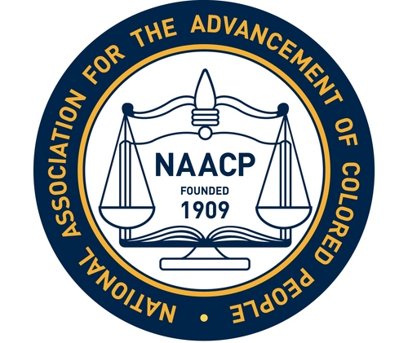
New Hope in a new century
In the early 1900s, two groups advanced the Court’s application of the 14th Amendment.
National Association for the Advancement of Colored People (NAACP) - Focused on civil rights (segregation laws).
American Civil Liberties Union (ACLU) - Focused on civil liberties (such as the freedom of speech).

Slide 11
New Hope in a new century
Abrams v. United States (1919) – the Court concluded that the language in leaflets handed out by a group of Russian-born political activists posed a “clear and present danger” to American society.
However, this decision contained a very important dissent from Justice Holmes (Judge) – he stated that “Clear and present danger” arguments should only be applied in cases where public safety was actually at risk. “Only an emergency”, he wrote, “warrants making any exception to the sweeping command, ‘Congress shall make no law abridging the freedom of speech.’”
This dissent would later influence the Court to take a more protective stance on free speech.

Slide 12
Incorporation: applying the bill of rights to the states
Not long after Abrams v. United States, in the case Gitlow v. New York, the Court reversed its previous position and said that the Due Process Clause of the 14th Amendment did extend the 1st Amendment to the states.
This process of applying the Bill of Rights to the states through Supreme Court Decisions is known as incorporation.
1st Amendment- Fully incorporated
2nd – Not incorporated
3rd- Not incorporated
4th- Fully incorporated
5th- Mostly incorporated
6th- Fully incorporated
7th- Not incorporated
8th- Mostly incorporated

Slide 13
The role of the supreme court today
The role of the Supreme Court is not to retry original cases, but rather to review the legal decisions made by the lower courts. (E.g.: Gitlow v. New York)
When the Supreme Court finds that a lower courts’ decision is unconstitutional, it may decide to reverse the decision.
Often, however, the case is returned to a lower appeals court in order to alter the original decision to conform to the Supreme Court’s opinion, dismiss the case, or order a new trial .
The decisions from the Supreme Court become a precedent, an example for all courts to follow in similar cases in the future.
Occasionally the Court overturns its own precedents.
That happened in Brown v. The Board of Education (1954). This case overturned Plessy v. Ferguson stating that “separate educational facilities are inherently unequal”, therefore it violates the 14th Amendment’s Equal Protection Clause.

Slide 14
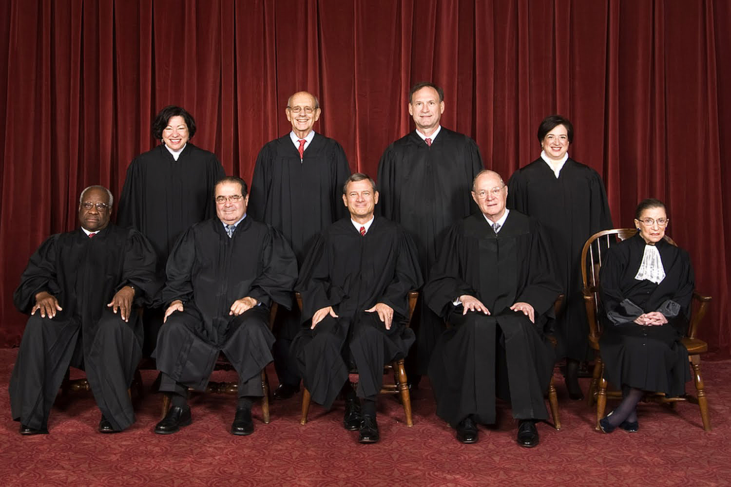
Supreme Court Justices

Slide 15
After going over the section, answer these questions:
Explain the difference between civil liberties and civil rights. Give at least two examples of each.
Discuss the significance of the Fourteenth Amendment and of Gitlow v. New York in terms of American civil liberties and civil rights.
What is the role of the Supreme Court today? What happens when the Court overturns a decision made by a lower court?

Slide 16
Homework
Read Chapter 5 Section 3

Slide 17
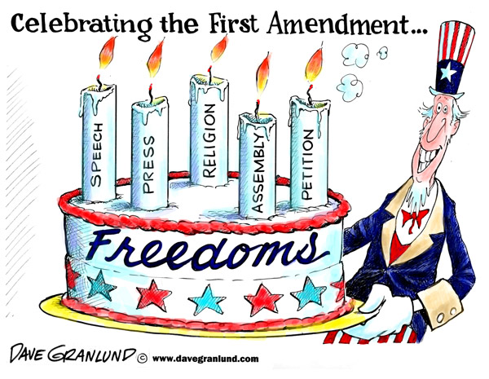
5.3: Your First Amendment rights
Includes freedoms of religion, speech, press, petition, and assembly.

Slide 18
FLORIDA Standards:
SS.7.C.2.5- Distinguish how the Constitution safeguards and limits individual rights.

Slide 19
Freedom of religion: the establishment clause
The 1st Amendment begins by stating that, “Congress shall make no law respecting an establishment of religion, or prohibiting the exercise thereof”.
This statement can be divided in two parts:
1) Establishment Clause - guarantees separation of church and state
2) Free Exercise Clause - establishes that all people are free to follow the religious practices of their choice, or no religion.

Slide 20
Freedom of religion: the establishment clause
Until the early 20th century, most children were educated in church-sponsored schools
Engel v. Vitale (1962) - Struck down the standard prayer each day in New York’s public schools - “a practice wholly inconsistent with the Establishment Clause”, (Justice Hugo Black)
Since this decision, the wall between religion and school has grown more solid.
Since school attendance is required by law, the Court argues that allowing religion in schools would be the same as teaching religion to the students by force.

Slide 21
Freedom of religion: the establishment clause
Lemon v. Kurtzman (1971)- Public funds to support private religious schools was deemed unconstitutional.
This case created a three-point “Lemon test” to see if government action violated the Establishment Clause.
To be constitutional, a government action must:
Have a secular (nonreligious), purpose,
Neither help nor hurt religion, and
Not result in an “excessive entanglement” of the government and religion.

Slide 22
Freedom of religion: the Free Exercise clause
Free Exercise Clause establishes that all people are free to follow religious practices of their choice
If religious faith conflicts with a law, THE LAW PREVAILS.
Reynolds v. United States (1879) - Law may not interfere with belief, it may interfere with practices.
Minersville School District v. Gobitis (1940) - Court decided against 2 kids who were suspended from school for refusing to say the Pledge of Allegiance because their religion (Jehovah’s Witnesses) viewed this as a form of idolatry prohibited by the Bible.
West Virginia State Board of Education v. Barnette (1943) - the Court reversed itself saying that Jehovah's Witnesses could refuse to salute flag. Their right to do so is protected under 1st Amendment.
The Court held that the Government must show a compelling interest in forcing people to obey a law that violates their religious convictions (beliefs).

Slide 23
Freedom of speech
The Supreme Court has generally supported freedom of speech unless the form of speech is harmful to others.
Two clear examples of this are:
Libel - Written False statements with intent to harm
Slander - Spoken
Another form of speech not protected under the first amendment is obscenity, or speech offensive to conventional standards of decency.

Slide 24
Freedom of speech
Brandenburg v. Ohio (1969) - The KKK (Ku Klux Klan) leader was arrested for giving a speech advocating illegal activities. The Supreme Court offered a two-part test to determine whether a “clear and present danger” exists that might justify suppressing free speech.
The Supreme Court must determine that:
Such speech has to be “directed to inciting or producing imminent lawless action”
The speech must be “likely to produce such action”
In this case the Supreme Court determined that the KKK leader’s speech, though containing hateful statements, was unlikely to produce such action. Thus, there was no “clear and present danger” and the KKK leader’s speech was protected under the 1st Amendment.
In 1989, extended the protection of the 1st Amendment to include symbolic speech (conduct that conveys a message without spoken word).
In Texas v. Johnson, the Supreme Court decided that flag burning is an expression of opinion that is protected by the 1st Amendment.

Slide 25
Freedom of speech
Some forms of pornography are protected speech, although the government may restrict children’s access to sexually graphic material.
In 1996 Congress passed the Communications Decency Act in order to try to regulate pornography on the internet.
A year later, in Reno v. American Civil Liberties Union, the Supreme Court struck it down because it was so vague it could limit most speech on the Internet.
The Supreme Court made it clear that in order to protect all speech, some offensive speech must be allowed to exist.

Slide 26
Freedom of press
“Were it left to me to decide whether we should have a government without newspapers or newspapers without government, I should not hesitate a moment to prefer the latter.”- Thomas Jefferson
The 1st Amendment makes it clear that free speech covers the media and the individuals.
Near v. Minnesota (1931) - Prior restraint (attempt by government to prevent publication or broadcast) is unconstitutional.
If it is believed that an article is libelous, the publisher can be sued after the article has been printed.
Keeping information from being published could be allowed ONLY under special circumstances, such as protecting National Security.
New York Times Co. v. United States (1971) – The federal government tried to invoke “national security” as grounds for prior restraint because of some leaked classified documents to the New York Times. The Supreme Court decided against the federal government saying that the papers had no effect on national security.
The 1st Amendment does not protect against libel. Unless it can be shown that what was printed was done intentionally and with the purpose to cause harm, you are not guilty of libel.

Slide 27
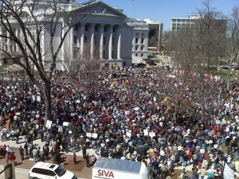
Freedom of assembly and the right to petition
The 1st Amendment protects “the right of the people peaceably to assemble, and to petition the Government for a redress of grievances.”
Many communities require a permit to assemble and some may try to block assembly through permit process.
This happened in Hague v. CIO (1937) – where the mayor of Jersey City applied a permit law unfairly because he disliked labor unions. The Supreme Court decided in favor of the labor union stating that rules must be enforced equally to all groups.
In terms of the right to petition there are not many cases, however, in NAACP v. Button (1963) the NAACP was trying to encourage African Americans who suffered from discrimination to take their cases to court. The state of Virginia accused them of seeking out legal business for financial gain but the Supreme Court concluded that they were instead helping people petition the government for their lawful rights. NAACP’s efforts were protected under the 1st Amendment.

Slide 28
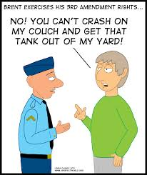
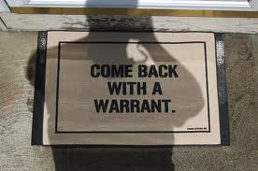
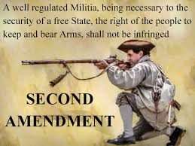
5.4 - Protections Against Abuses of government Power
The 2nd, 3rd, and 4th Amendments were a response to suppression of rights under British Colonial rule

Slide 29
FLORIDA Standards:
SS.7.C.3.6- Evaluate Constitutional rights and their impact on individuals and society.
SS.7.C.3.12- Analyze the significance and outcomes of landmark Supreme Court cases.

Slide 30
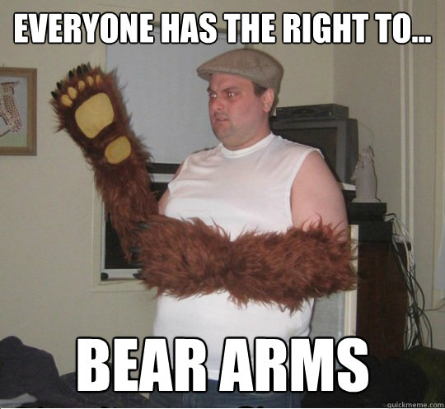
The second amendment and the right to bear arms
The 2nd Amendment says, “A well regulated Militia, being necessary to the security of a free State, the right of the people to keep and bear Arms, shall not be infringed.”
In colonial times, people relied on local militias to provide security for their communities.
The Constitution allowed Congress to create a national army and navy, but the framers were wary of standing armies.
The framers feared that the central government would use the army to suppress citizens’ rights.
This amendment was built into Bill of Rights for the purpose of freedom and security.
The 2nd Amendment has not been incorporated, meaning that most regulation of firearms is in the hands of the state and local governments.

Slide 31
The second amendment and the right to bear arms
In 1934, an increase in gang violence and an attempt on President Franklin Roosevelt’s life led to the first federal gun control law.
This law placed tax on certain powerful firearms and required background checks.
U.S. v. Miller (1939) – The Court supported the conviction of two men who failed to register a sawed-off shotgun. The Court determined that government had the right to regulate such weapons.

Slide 32
The third and fourth amendment: protecting your home and person
These amendments are designed to protect the privacy and property rights of citizens from abuses by law enforcement or military.
The 3rd Amendment: Prohibits citizens from being forced to take soldiers into their homes. It offers a general guarantee for the privacy and sanctity of people’s homes.

Slide 33
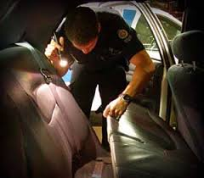
The third and fourth amendment: protecting your home and person
The 4th Amendment: Forbids “unreasonable searches and seizures” of individuals or their property without a properly executed warrant (written approval from a judge).
A law enforcement officer may not search person or property without consent or legal order.
Warrant must be based on probable cause (reasonable suspicion of criminal behavior).
Warrant must be specific and describe the person, place, or thing to be searched.
Warrant not needed for:
Criminal activity in plain view
Probable cause to believe suspect is trying to destroy evidence
Searches of students and their possessions by school officials

Slide 34
The third and fourth amendment: protecting your home and person
There have been many cases involving search and seizure. A few of the landmark cases are listed below.
Katz v. United States (1967) – A person has “reasonable expectation of privacy” in a phone booth (a warrant is required).
This case involved the police recording a suspect’s conversation from a public phone booth.
Terry v. Ohio (1968) - Officer observations (suspicions) provide adequate cause for a search.
The behavior of three men caused the officer to believe that they were about to rob a store.
After questioning the men, the officer frisked the men and found a gun on two of them. They were later convicted of carrying a concealed weapon.
The search was considered reasonable given the behavior of the suspects .

Slide 35
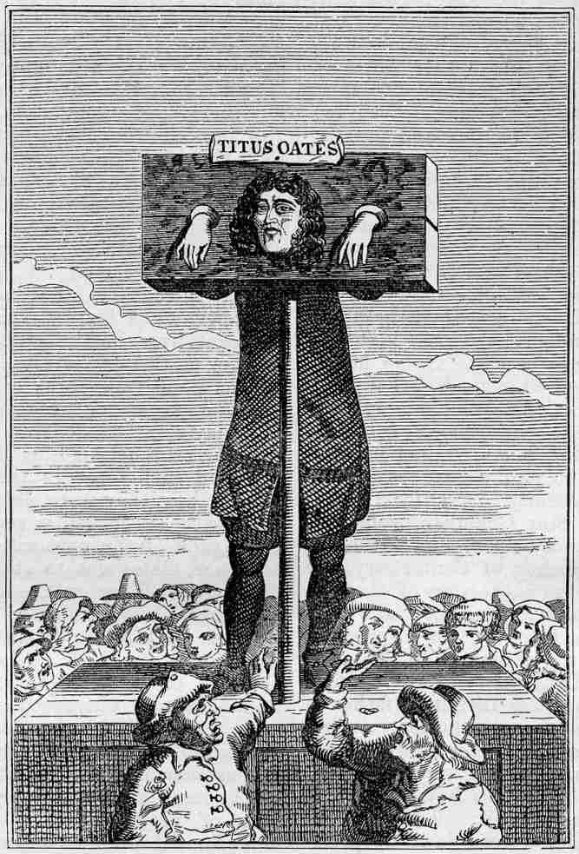
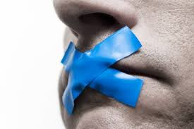
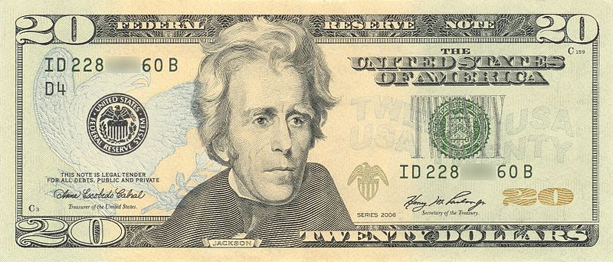
5.5- Your right in the legal system
The 5th, 6th, 7th, and 8th Amendments concern the protection of rights in the judicial process.

Slide 36
FLORIDA Standards:
SS.7.C.3.6 - Evaluate Constitutional rights and their impact on individuals and society.
SS.7.C.3.12 - Analyze the significance and outcomes of landmark Supreme Court cases.

Slide 37
The fifth amendment: your rights when accused of a crime
A common phrase is heard when a suspect is arrested for a crime, “you have the right to remain silent”- 5th Amendment
Protects against self-incrimination, or saying anything that might imply their own guilt.
Made to prevent law enforcement officers (LEOs) from pressuring suspects into admitting crimes they did not commit.
Miranda v. Arizona (1966) – the Court set forth a procedure for ensuring that suspects know their rights. LEOs must warn a suspect of their 5th Amendment right to remain silent to avoid self-incrimination, any statement that he makes may be used against him, and the right to the presence of an attorney.

Slide 38
The fifth amendment: your rights when accused of a crime
The 5th Amendment protects against double jeopardy - if person is tried for a crime and found not guilty, prosecutors cannot try that person in court for the same crime.
The 5th Amendment also states that no one may be “deprived of life, liberty, or property, without due process of law”. This protection is known as the Due Process Clause (also appears in the 14th Amendment).
The 5th Amendment also contains the Taking Clause - Government may not take private property for public use “without just compensation” (eminent domain).

Slide 39
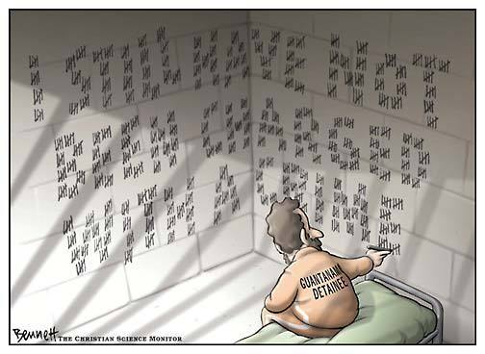
The sixth and the seventh amendment: your right to a fair trial
6th Amendment - Criminal trials must be carried out quickly, publicly, and in front of an impartial jury.
The defendant has the right to legal counsel and the right to see the evidence being used against him/her in trial.
Gideon v. Wainwright (1963) – The Courts concludes that the 6th Amendment’s guarantee of legal counsel should not depend on someone’s ability to pay for representation (an attorney).
Gideon was a poor, uneducated ex-convict who was arrested in Florida for the crime of theft. He did not have the funds to afford legal representation. The State of Florida only appointed counsel to defendants involved in a death penalty case. Gideon was found guilty of theft and sentenced to 5 years in prison. While in prison, Gideon educated himself on his legal rights and filed an appeal. His case was retried and he was found not guilty.

Slide 40
The sixth and the seventh amendment: your right to a fair trial
At times, a defendant’s 6th Amendment rights might conflict with other rights and liberties.
Sheppard v. Maxwell (1954) – Sheppard was charged with killing his wife. Throughout the trial, the press covered the story relentlessly, almost making it seem that Sheppard was guilty. Eventually, Sheppard was found guilty. Sheppard appealed arguing that the press coverage had prevented him from getting a fair trial. The Court overturned the murder conviction, Sheppard was retried and found not guilty.
The Court acknowledged the media’s 1st Amendment rights to press coverage of the trial, but the Court said that press coverage should not be allowed to interfere with a defendant’s right to due process.
In cases where intense media coverage might unfairly influence the trial, the trial should be moved to another location or the jury should be isolated from all news coverage.

Slide 41
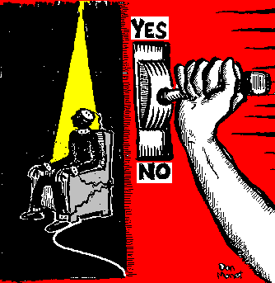
The eighth amendment: your protection from excessive bail and punishments
Protects against excessive bail (money given over to the court in exchange for a suspect’s release until his or her trial begins), fines, or cruel and unusual punishments.
Definition of “cruel and unusual” changes over time.
Capital punishment - (death penalty) In re Kemmler (1890) case says all methods of execution acceptable as long as it does not involve “torture or lingering death”.
Furman v. Georgia (1972) - Death penalty was cruel and unusual when it is inconsistently and unequally applied from one case to another. This decision temporarily paused all executions in the United States.
Gregg v. Georgia (1976) - After many states changed their laws in order to apply the death penalty in a more consistent manner, the death penalty was considered constitutional under the new laws.

Slide 42
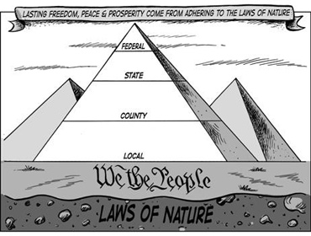
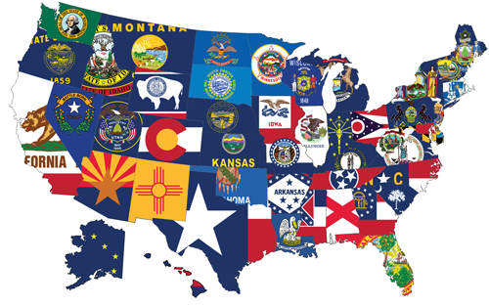
5.6- Rights and powers of the states and the people

Slide 43
FLORIDA Standards:
SS.7.C.3.6 - Evaluate Constitutional rights and their impact on individuals and society.
SS.7.C.3.12 - Analyze the significance and outcomes of landmark Supreme Court cases.

Slide 44
The ninth amendment: your rights beyond those listed on the constitution
The 9th Amendment is the Bill of Rights’ “safety net”.
The 9th Amendment says that other rights and liberties may exist beyond those listed in the Constitution, and it offers protections for those unenumerated rights.
Griswold v. Connecticut (1965) – Estelle Griswold was arrested for providing medical advice to married couples on how to prevent pregnancy. Her actions violated a Connecticut law that prohibited the use of contraceptives. The Court declared that the law violated marital privacy rights, and that the 9th Amendment includes the right to privacy.
The Court concluded that the right to privacy is an implied right in the 1st, 3rd, and 4th Amendments, and that the 9th Amendment provides further support by stating that a right need not to be cited in the Constitution to be valid.
The scope of the right to privacy remains a contested issue and has not been fully resolved by the Court.

Slide 45
The tenth amendment: powers reserved for the states and the people
The 10th Amendment is more concerned with the issue of federalism (the balance of federal and state powers), than with individual rights. It limits the powers of the federal government to those granted under the Constitution, reserving other powers for the states and the people.
States must uphold laws enacted by Congress, federal law takes precedence under the Supremacy Clause of Article VI.
For example: Laws governing marriage and divorce are left to the states.
Another example: United States v. Morrison (2000) - Outlawed Violence Against Women Act which allowed victims of domestic violence to sue their attackers in federal court.
The Supreme Court struck down the law, saying that violent crime between individuals was an issue for the states, not the federal government.

